Slide 1
Advance Augmented Reality Battle-system (AARB)
CS 337 Software Design
Group 4
Prepared By:
Namba, Kazuya
Liang, Tony
Lee, Hsu Peng
Hsu, Michael

Slide 2
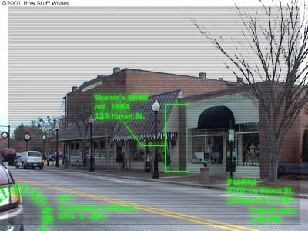
Brief Overview
A completely cloud-based Application
Similar to Mainframe
Provides exciting augmented reality experience

Slide 3
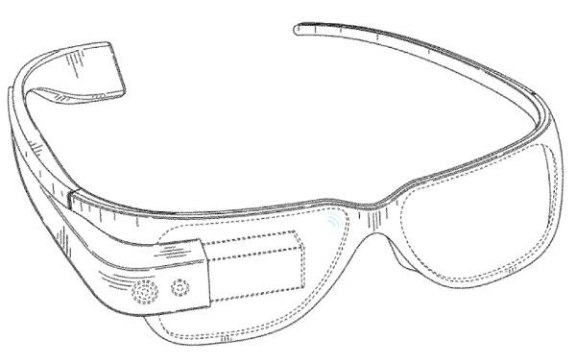

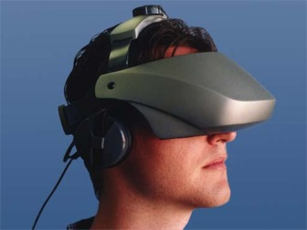

Hardware
User End: Project Glass - augmented reality head-mounted display (HMD)
HMD in the past HMD in the present

Slide 4
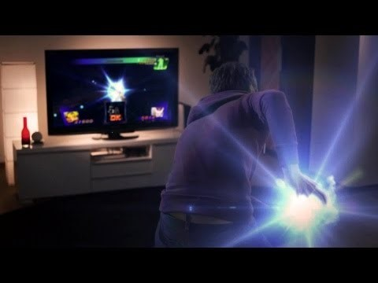
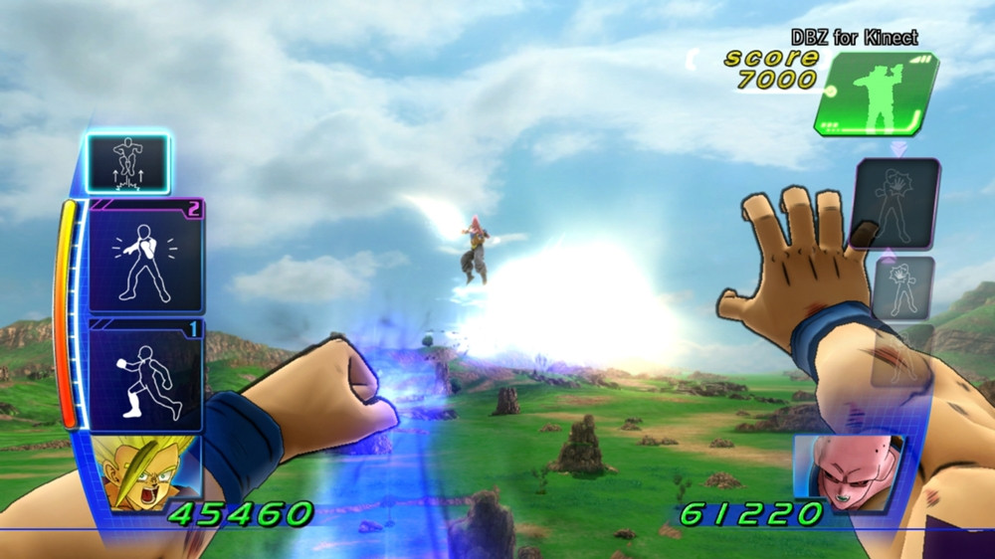
Inspiration
Dragon Ball for Kinect

Slide 5
Level 0 DFD
Advance Augmented Reality Battle-system (AARB)
Main Control
Login
Sound Recognition
Motion Recognition
Battle
Shop
Location Service
User Profile
H/W
Control
Signals
User Input
User
Hardware

Slide 6
Level 1 DFD

Slide 7
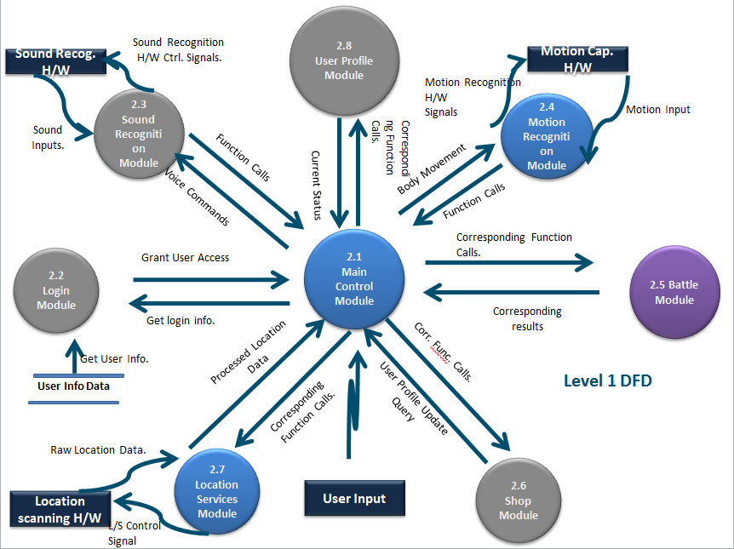

Slide 8
2.1 Main Control Module

Slide 10
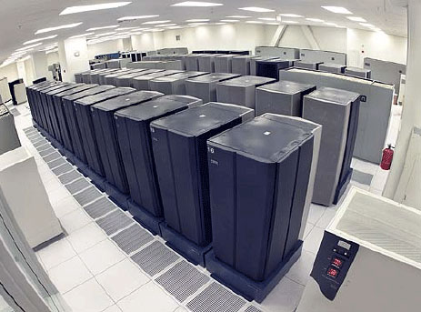
2.1 Main Control Module
Located on the server
Instantiates a graphical user interface when user logs in to the server
Responsible for intercommunication between all modules

Slide 11
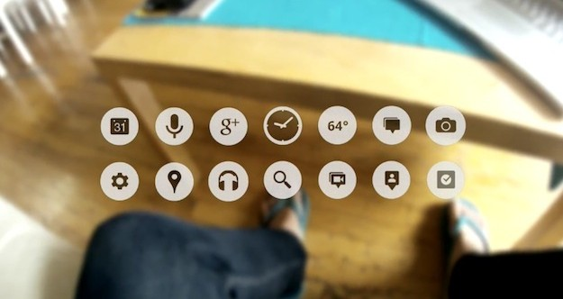
Submodules
User Interface Submodule: Instantiated every time the user connects

Slide 12
Requirements
Requirement No. | Requirement Description
User Interface Submodule (UIS)
3.1.1.1 | UIS shall be instantiated every time the user launches the game.
3.1.1.2 | UIS shall be a GUI with scrolling menus.
3.1.1.3 | UIS shall display user controllable options.
3.1.1.4 | UIS shall take user input using the Data Input Controller Submodule.
3.1.1.5 | UIS shall display any significant errors or messages to the user.

Slide 13
Submodules Conti.
Data Input Controller Submodule: Controls GUI display mode and input methods.
Determine State of User: IB/NIB
Control Input method
Switch user interface

Slide 14
Submodules Conti.
Information Bus Submodule: Oversees and Controls all information and commands between all modules.
Commands
Information
Commands
*this is a bus

Slide 15
2.5 Battle Module

Slide 17
2.5 Battle Control Module (BCM)
Battle Interface Submodule (BIS)
Display user interface
Generate special effects
Matchmaking Submodule (MMS)
Setup new battle
Show result
Battle Calculation Submodule (BCS)
Do calculation and control system during the battle
Battle Data Submodule (BDS)
Store current data

Slide 18
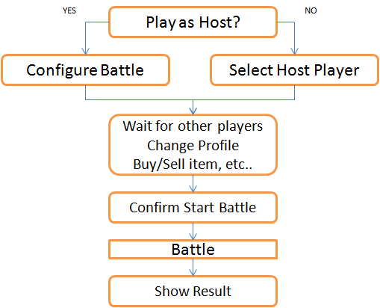
Battle Interface Submodule (BIS)
Display User Interface

Slide 19
Battle Interface Submodule (BIS)
During Battle
Show current battle information
Display time, location, player status
Popup messages, errors
Enable users to access battle information
User Profile
Game Setting
Help
Exit
Generate special effects

Slide 20
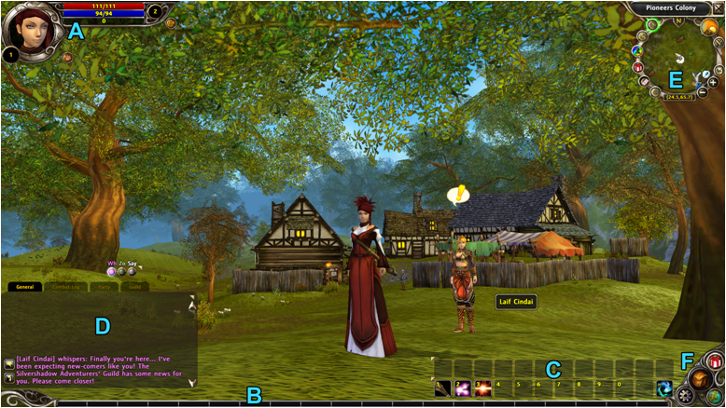

Slide 22
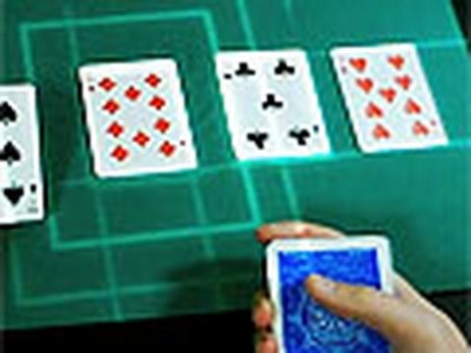
Special Effects

Slide 23
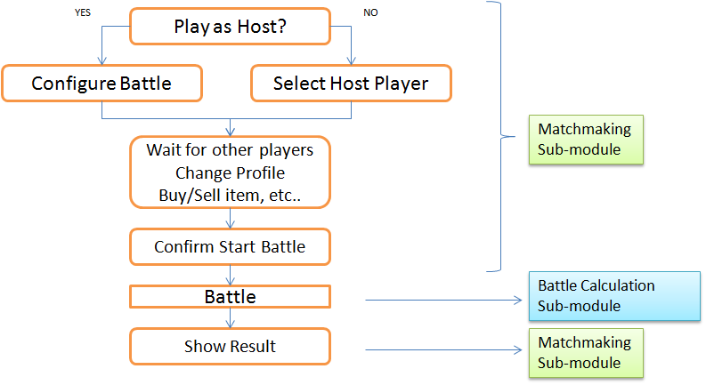
Matchmaking Submodule (MMS) and Battle Calculation Submodule (BCS)
These two submodules control the system

Slide 24
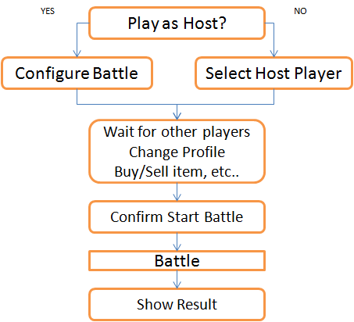
Matchmaking Submodule (MMS)
Choose if play as Host
Host setups battle environment
Time Limit
# of Players
Battlefield
Non-Host Player choose Host
List all Host players
View joined players
Enable player to access
Shop Module
User Profile Module
Confirm players to begin the battle
Show results after each battle
Exp. earned
Item/skill earned
Score
Enable player to exit the battle

Slide 25
Battle Calculation Submodule (BCS)
Input must comes from Sound/Motion Recognition Modules.
For any case, BCS access the Battle Data Submodule to obtain data of all players involved.
BCS may access the skill database as necessary.
After calculation, BCS returns the result and stores it into User Profile Module.
Generate warning as player gets too close to edge of the battlefield
Generate message as battle reaches close to time limit
Generate warning if network is unavailable

Slide 26
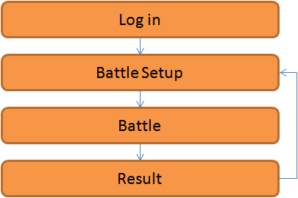
Battle Calculation Submodule (BCS)
Control the system after user logged in

Slide 27
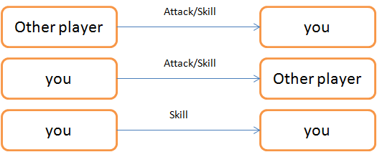
Battle Calculation Submodule (BCS)
Battle Calculation Submodule controls the battle part.
Calculation Patterns

Slide 28
Battle Data Submodule (BDS)
Store battle environment data
Time
Location
Network
Store player data (all players in the battle)
Status
Skill
Equipment
Money
Location

Slide 29
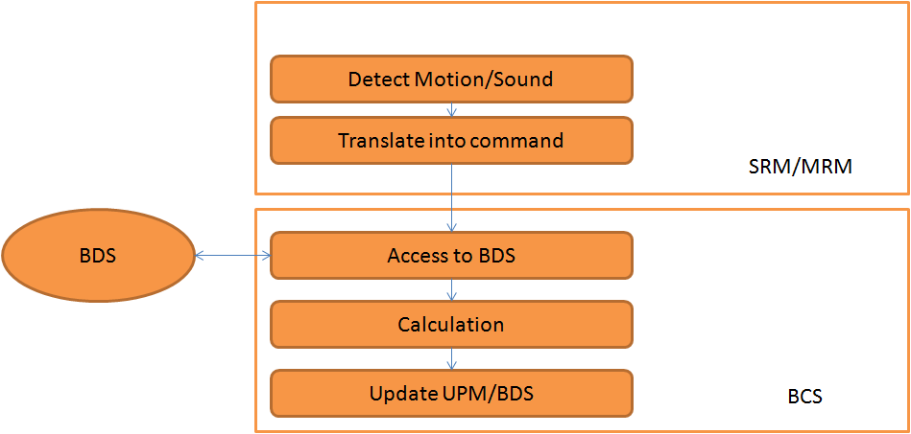

Slide 30
2.6 Shop Module

Slide 32

2.6 Shop Module (SM)
Search Categories Submodule (SCS)
Providing searching bar function
Sorting items and skills by grade
Matching categories like weapons, armors, potions, fireball skills, ice ball skills, and lightning ball skills
Organizing all items and skills

Slide 33
Calculation Item Submodule (CIS)
Calculation Skills Submodule (CSS)
Doing calculation when user is purchasing items or skills
Displaying full price of items and skills
Adding funds to Shop Module (SM)
Subtracting funds to Shop Module (SM)

Slide 34

User Transaction Submodule (UTS)
Getting golds system
100 golds $1
250 golds $2
400 golds $3
600 golds $4
900 golds $5
Providing several puchase methods
Pay card method (Visa, Master Card, American Express)
PayPal method
Mobile payment method
Prepaid card method
Paysafecard method

Slide 35
2.7 Location Service Module

Slide 37
2.7 Location Service Module (LSM)
LSM controls GPS H/W.
Geographic Scanning Submodule (GSS)
Generates 2D/3D battlefield map
Data will be stored in BDS (Battle Data Submodule).
Location Tracking Submodule (LTS)
LTS continuously tracks user location.

Slide 38
2.8 User Profile Module

Slide 40
2.8 User Profile Module
Updates user assets upon store transactions
Increments user level when enough experience is gained from battle or training
Increments user skill levels when skills are purchased in shop or upgraded
Recalculates user currency depending on user spendings and earnings
Confirms item pickup and item placement in inventory
Displays user location using LSM
Shows user’s stats
Handles user profile customization

Slide 41

Submodules
User Assets Submodule (UAS)
User Experience Submodule (UES)
User Skills Submodule (USS)
User Items Submodule (UIS)
User Location Submodule (ULS)
User Statistics Submodule (USTS)

Slide 42
User Assets Submodule (UAS)
Requirement No. | Requirement Description
User Assets Submodule (UAS)
3.8.1 | UAS shall process all user transactions with the SM to the UPM.
3.8.1.1 | UAS shall update the UPM when the transaction was successful.
3.8.1.2 | UAS shall cancel the transaction when errors occurred.
3.8.1.2.1 | UAS shall not let the transaction go through if the user does not have sufficient funds.
3.8.1.3 | UAS shall subtract the user’s funds when the user bought asset(s).
3.8.1.3.1 | UAS shall transfer the correct asset(s) to the user when the user bought the asset(s).
3.8.1.4 | UAS shall add funds to the user when the user sold his or her asset(s) to the shop.
3.8.1.4.1 | UAS shall take the correct asset(s) from the user when the user sold the asset(s).

Slide 43
User Experience Submodule (UES)
Requirement No. | Requirement Description
User Experience Submodule (UES)
3.8.2 | UES shall process all experiences given to the user to the UPM.
3.8.2.1 | UES shall have every new user’s experience start at zero.
3.8.2.2 | UES shall calculate the user’s experience required to advance to the next level.
3.8.2.3 | UES shall add experience calculated from the BCS to the user when the user won a battle.
3.8.2.4 | UES shall add experience to the user when the user does any physical training or exercise.
3.8.2.5 | UES shall not ever take away the user’s experience under any circumstances.
3.8.2.6 | UES shall increment the user’s level when he or she has the required experience.
3.8.2.6.1 | UES shall not reset the user’s experience back to zero every time the user advanced a level.

Slide 44
User Skills Submodule (USS)
Requirement No. | Requirement Description
User Skills Submodule (USS)
3.8.3 | USS shall process all user skills related information to the UPM.
3.8.3.1 | USS shall provide the user with basic skills.
3.8.3.2 | USS shall have three types of skills.
3.8.3.2.1 | USS shall have physical skills.
3.8.3.2.1.1 | USS shall drain the user’s endurance or stamina when using physical skills.
3.8.3.2.2 | USS shall have active skills.
3.8.3.2.2.1 | USS shall drain the user’s mana when using active skills.
3.8.3.2.3 | USS shall have passive skills.
3.8.3.2.3.1 | USS shall not drain anything from the user when using passive skills.
3.8.3.3 | USS shall unlock new skills for the user when he or she bought them from the shop.
3.8.3.4 | USS shall unlock new skills for the user when he or she meets the level requirement.
3.8.3.5 | USS shall increment a skill’s level when the user bought an upgrade from the shop.
3.8.3.6 | USS shall make all user changes to his or her skill(s) to be permanent.
3.8.3.6.1 | USS shall not allow the user’s skills to be transferable.
3.8.3.6.2 | USS shall not allow the user’s skills to be refundable.
3.8.3.6.3 | USS shall not allow the user’s skills to be tradable.

Slide 45
User Items Submodule (UIS)
Requirement No. | Requirement Description
User Items Submodule (UITS)
3.8.4 | UITS shall process all user interactions with items to the UPM.
3.8.4.1 | UITS shall set the same maximum number of inventory slots that every user has.
3.8.4.2 | UITS shall show name labels next to every item the user has.
3.8.4.3 | UITS shall show a brief description of every item the user has.
3.8.4.4 | UITS shall add the item to the user’s inventory when the user picked it up.
3.8.4.5 | UITS shall add the correct asset(s) to the user’s inventory when the user bought them from the shop.
3.8.4.6 | UITS shall remove the asset(s) from the user’s inventory when the user sold them to the shop.
3.8.4.7 | UITS shall categorize every equipment the user has to the appropriate body part.
3.8.4.7.1 | UITS shall label every equipment the user has with the appropriate body part.
3.8.4.7.2 | UITS shall not allow the user to equip the equipment to the wrong body part.
3.8.4.7.2.1 | UITS shall only allow one equipment to be equipped at a time for each part of the user’s body.
3.8.4.7.2.1.1 | UITS shall only allow one equipment to be equipped at a time as the user’s headgear.
3.8.4.7.2.1.2 | UITS shall only allow one equipment to be equipped at a time as the user’s eyewear.
3.8.4.7.2.1.3 | UITS shall only allow one equipment to be equipped at a time as the user’s nose wear.
3.8.4.7.2.1.4 | UITS shall only allow one equipment to be equipped at a time as the user’s mouth gear.
3.8.4.7.2.1.5 | UITS shall only allow one equipment to be equipped at a time as the user’s ear wear.
3.8.4.7.2.1.6 | UITS shall only allow one equipment to be equipped at a time as the user’s neckwear.
3.8.4.7.2.1.7 | UITS shall only allow one equipment to be equipped at a time as the user’s arm wear for each arm.
3.8.4.7.2.1.8 | UITS shall only allow one equipment to be equipped at a time as the user’s wrist wear for each wrist.

Slide 46
User Items Submodule (UIS) Conti.
Requirement No. | Requirement Description
User Items Submodule (UITS)
3.8.4.7.2.1.9 | UITS shall only allow one equipment to be equipped at a time as the user’s finger wear for each finger of each hand of the user.
3.8.4.7.2.1.10 | UITS shall only allow one equipment to be equipped at a time as the user’s torso gear.
3.8.4.7.2.1.11 | UITS shall only allow one equipment to be equipped at a time as the user’s back wear.
3.8.4.7.2.1.12 | UITS shall only allow one equipment to be equipped at a time as the user’s legwear.
3.8.4.7.2.1.13 | UITS shall only allow one equipment to be equipped at a time as the user’s footwear for each foot.
3.8.4.7.2.1.14 | UITS shall only allow at most two weapons to be equipped at a time.
3.8.4.7.2.1.14.1 | UITS shall only allow two weapons to be equipped at a time if the two weapons are lightweight.
3.8.4.7.2.1.14.2 | UITS shall only allow at most one weapon to be equipped at a time if the weapon is heavyweight.
3.8.4.7.2.1.14.3 | UITS shall allow one weapon and one shield to be equipped at the same time.

Slide 47
User Location Submodule (ULS)
Requirement No. | Requirement Description
User Location Submodule (ULS)
3.8.5 | ULS shall process the user’s current location from the LSM to the UPM.
3.8.5.1 | ULS shall record the user’s exact location.
3.8.5.2 | ULS shall translate the user’s exact location to the full street address.
3.8.5.2.1 | ULS shall display the user’s full street address.
3.8.5.3 | ULS shall display a map view with a character icon at the user’s current location.
3.8.5.3.1 | ULS shall display the direction the user is currently facing.

Slide 48
User Statistics Submodule (USTS)
Requirement No. | Requirement Description
User Statistics Submodule (USTS)
3.8.6 | USTS shall process the user’s statistics to the UPM.
3.8.6.1 | USTS shall display the user’s profile name.
3.8.6.2 | USTS shall display the user’s location.
3.8.6.3 | USTS shall display the user’s current game status.
3.8.6.3.1 | USTS shall display the current game status as In Battle (IB) if the user is in battle.
3.8.6.3.2 | USTS shall display the current game status as Not In Battle (NIB) if the user is not in battle.
3.8.6.4 | USTS shall display the user’s level.
3.8.6.5 | USTS shall display the user’s experience.
3.8.6.6 | USTS shall display the current equipment the user is wearing.
3.8.6.6.1 | USTS shall change the user’s appearance when the user equips any of his or her equipment.
3.8.6.6.2 | USTS shall change the user’s appearance when the user removes or changes any of his or her equipment.
3.8.6.7 | USTS shall display the user’s current health.
3.8.6.8 | USTS shall display the user’s current mana.
3.8.6.9 | USTS shall display the user’s current endurance.
3.8.6.10 | USTS shall display the user’s current stamina.
3.8.6.11 | USTS shall display the user’s strengths.
3.8.6.12 | USTS shall display the user’s weaknesses.
3.8.6.13 | USTS shall display the user’s immunities.
3.8.6.14 | USTS shall display the user’s skills.

Slide 49
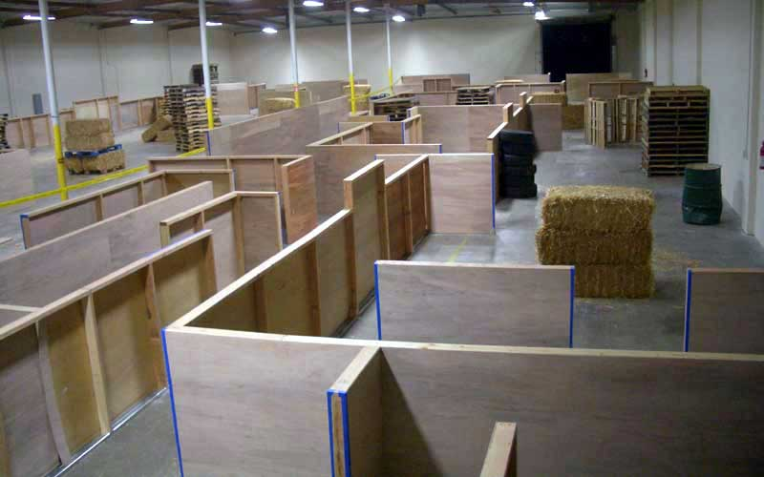
Future Possibilities
Linking User Profile Module with Google accounts
Users can upload their own battle areas.
Training mode: Working out in real life translates to experience in game
Work with airsoft facilities to create dedicated battle areas

